Slide 1
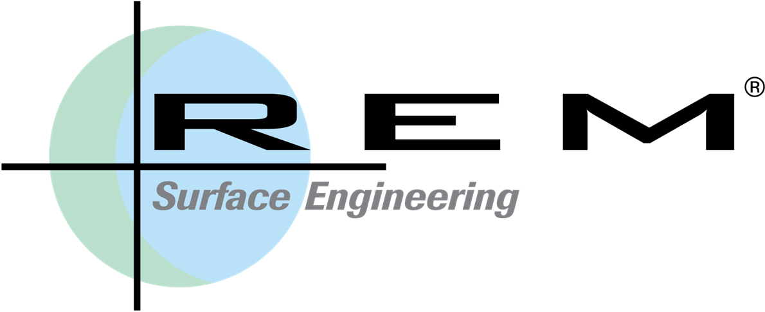
The Basics of Automotive Surface Engineering by Isotropic Superfinishing
Bill Nebiolo
Sr. Tech. Acct. Eng’r; Midwest U.S.A.
Email: bnebiolo@remchem.com
Website: www.remchem.com
© 2015 REM Chemicals, Inc. All rights reserved REM, ISF and REM Surface Engineering are registered trademarks of REM Chemicals, Inc. This presentation contains confidential and proprietary information of REM Chemicals, Inc., and may not be reproduced or redistributed without the express written consent of REM Chemicals, Inc.
REM®, ISF®, FERROMIL®, & MAGALLOY® are a registered trademarks of REM Chemicals Inc.

Slide 2
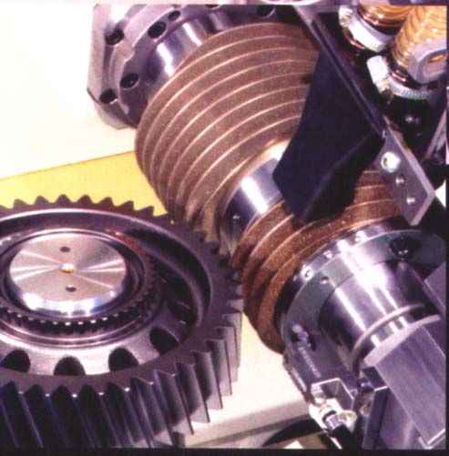
Traditional Processing; Grinding or Lapping
Post Heat Treatment Grinding
Post heat treat
grinding removes
quench distortion
© 2015 REM Chemicals, Inc.

Slide 3
Traditional Ground Finish; Part is ready for installation
Beveled Spur Gear After Tooth Grinding
Note; tooth
showing
grind lines
© 2015 REM Chemicals, Inc.

Slide 4
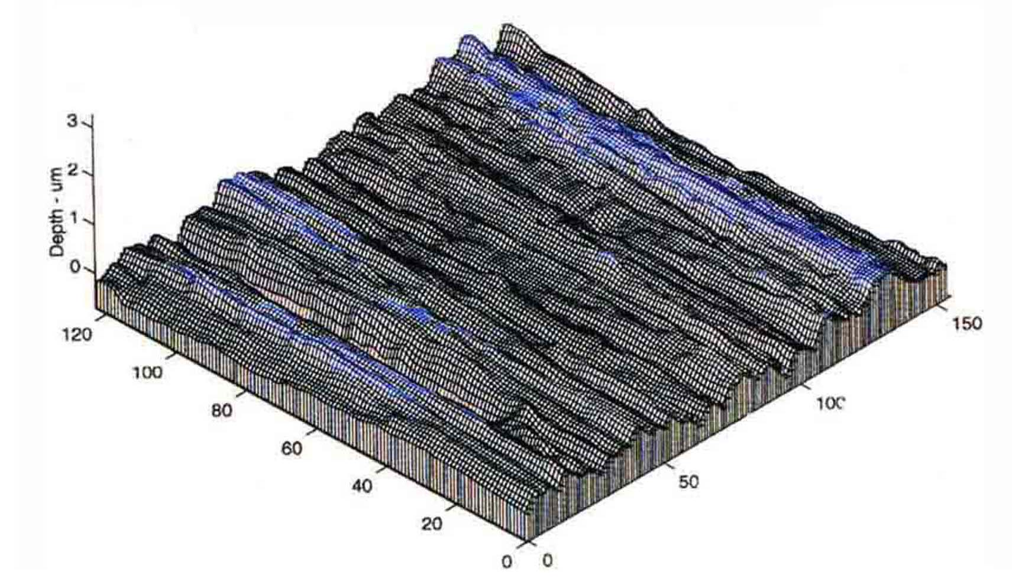
Traditional Ground Surface; Unidirectional & Failure Initiative
Magnified View of Ground Tooth Flank
© 2015 REM Chemicals, Inc.

Slide 5
As Ground Opposing Surfaces; Contact Inefficiency
The two opposing as-ground tooth flank surfaces during the initial break-in phase
Initial contact during break-in period is asperity to asperity
Gear mesh compressive stress on opposing tooth flanks is concentrated into just a few asperity-to-asperity contact locations
© 2015 REM Chemicals, Inc.

Slide 6
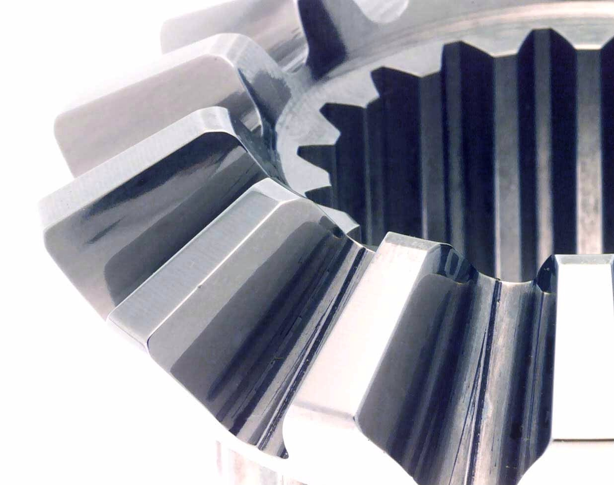
ISF Processed Part; Controlled Asperity Planarization
Beveled Spur Gear After ISF Processing
Same gear tooth after ISF, surface asperities planarized
© 2015 REM Chemicals, Inc.

Slide 7
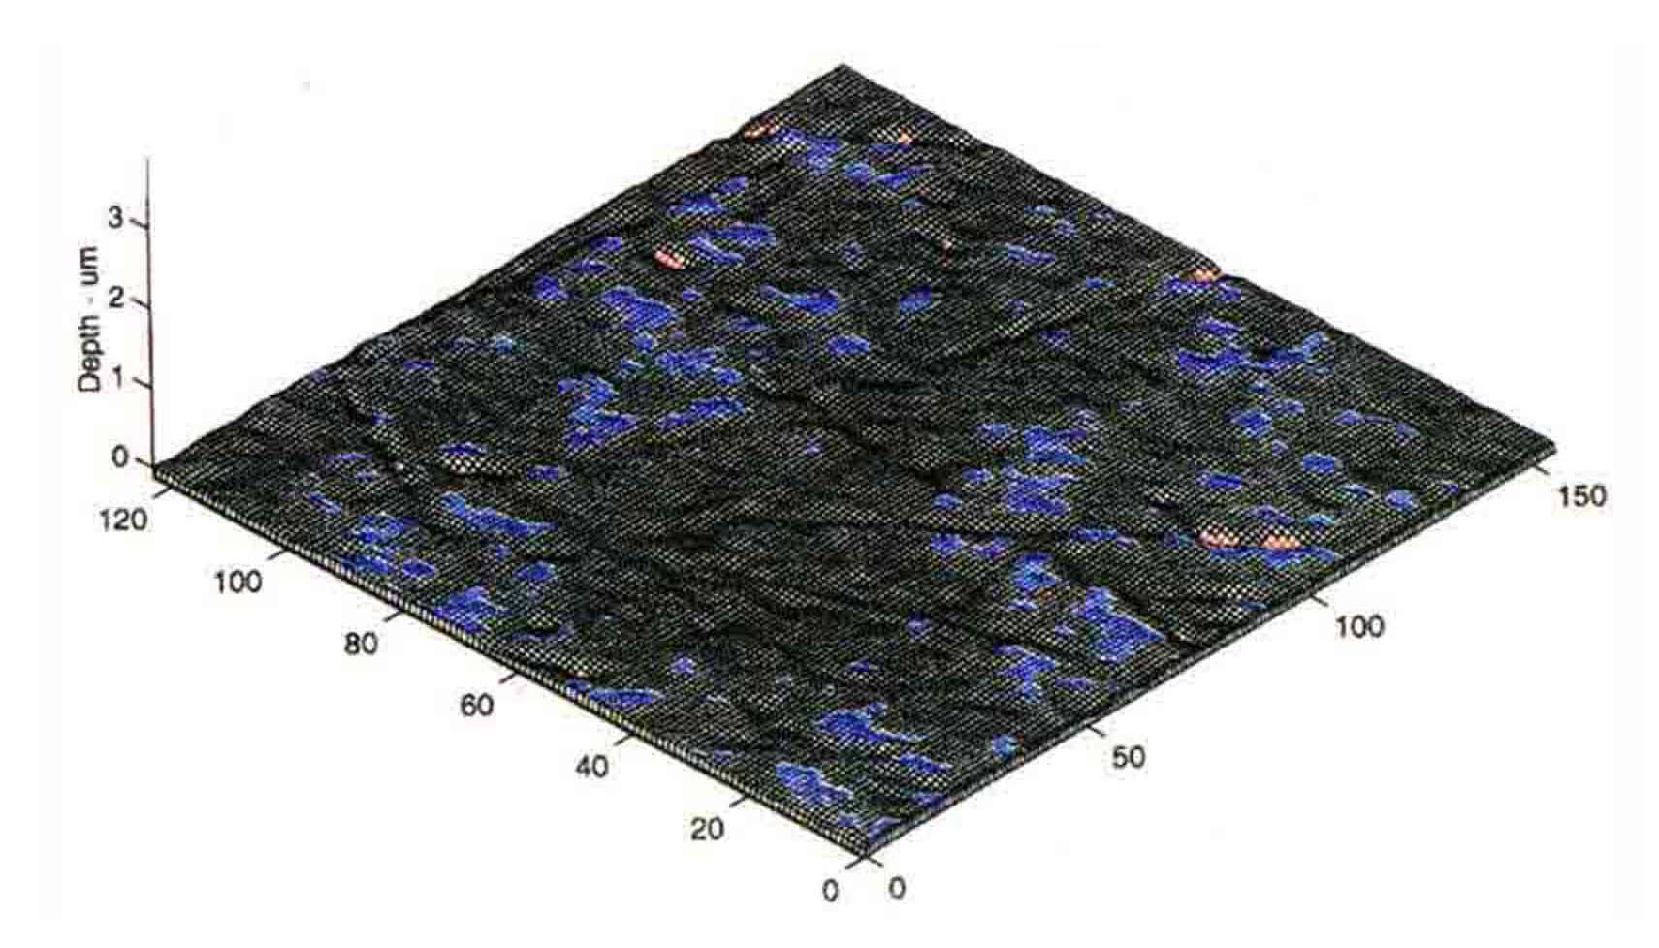
ISF Surface; Non-directional & Textured for Lube Retention
REM ISF Isotropic Super Finish Enhanced Surface Texture
© 2015 REM Chemicals, Inc.

Slide 8
The ISF Process; Asperities Planarized
Two REM ISF gear tooth flanks during initial contact loading
Asperities have undergone controlled leveling
Gear mesh compressive stress on opposing tooth flanks is much lower because it is now diffused across a larger surface area.
© 2015 REM Chemicals, Inc.

Slide 9
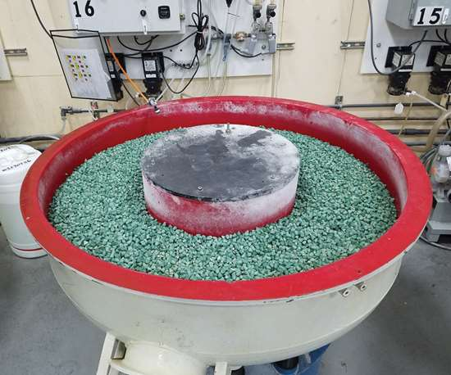
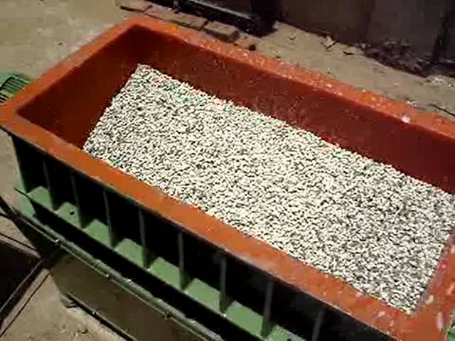
The ISF Process; Processing Equipment Traditional
ISF is Generated in a Vibratory Bowl or a Vibratory Tub
© 2015 REM Chemicals, Inc.

Slide 10
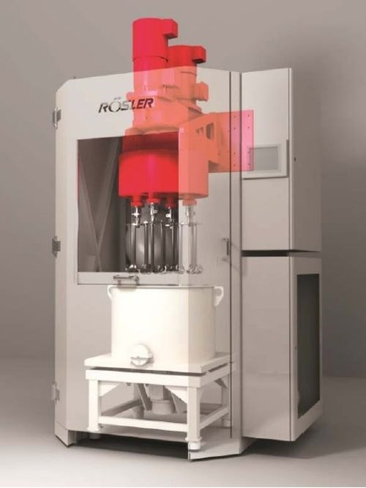
The ISF Process; Processing Equipment Rapid ISF
Rapid ISF
Drag Finisher
Combine drag finisher with chemical accelerator to ISF gearsets in just one minute
© 2015 REM Chemicals, Inc.

Slide 11
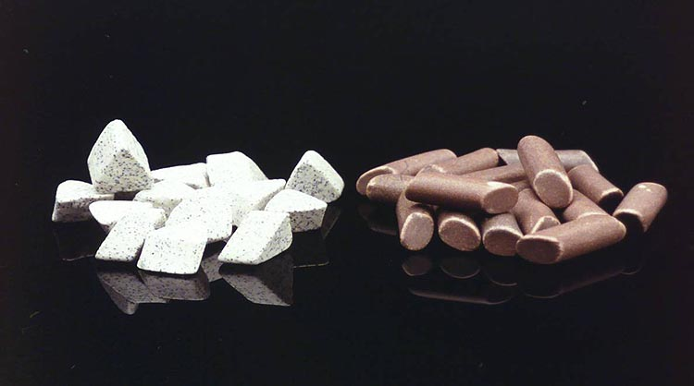
Non-Abrasive Media for Controlled Asperity Removal
Traditional Abrasive Vibe Media
REM ISF Media
Abrasive Angle Cut Triangles Note: Aluminum Oxide Grit
High Temperature Fired Vitrified, Non-Abrasive High Density Media
© 2015 REM Chemicals, Inc.

Slide 12
The ISF Process; Planarization Mechanism
7x Photomicrograph of as-ground tooth flank
Ground starting condition
Ra = 55 µin. (1.37 µm)
Rmax = 470 µin. (11.8 µm)
Profilometry Trace
© 2015 REM Chemicals, Inc.

Slide 13
The ISF Process; Planarization Mechanism
The ISF Process
ISF® chemistry forms a soft surface conversion coating.
Coating is softer than the part upon which it has formed.
© 2015 REM Chemicals, Inc.

Slide 14
The ISF Process; Planarization Mechanism
The ISF Process
Media wipes soft conversion coating from the tops of the asperities and asperities begin to planarize
© 2015 REM Chemicals, Inc.

Slide 15
The ISF Process; Planarization Mechanism
7x Photomicrograph after a short period of time
Partial asperity planarization
Ra = 23 µin. (0.57 µm)
Rmax = 187 µin. (4.67 µm)
Profilometry Trace shows partial asperity planarization
© 2015 REM Chemicals, Inc.

Slide 16
The ISF Process; Planarization Mechanism
The ISF Process
Coating reforms on partially planarized asperities and additional media wiping continues planarization
© 2015 REM Chemicals, Inc.

Slide 17
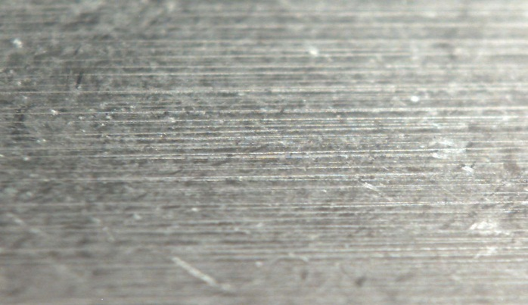
The ISF Process; Planarization Mechanism
7x photomicrograph a little while longer
Significant asperity planarization
Ra = 12 µin. (0.3 µm)
Rmax = 95 µin. (2.4 µm)
Profilometry tracing shows substantially planarized asperities
© 2015 REM Chemicals, Inc.

Slide 18
ISF Processing; Burnish to produce clean final surface
The ISF Process
When desired Ra is achieved a soap burnishing step removes the ISF coating
© 2015 REM Chemicals, Inc.

Slide 19
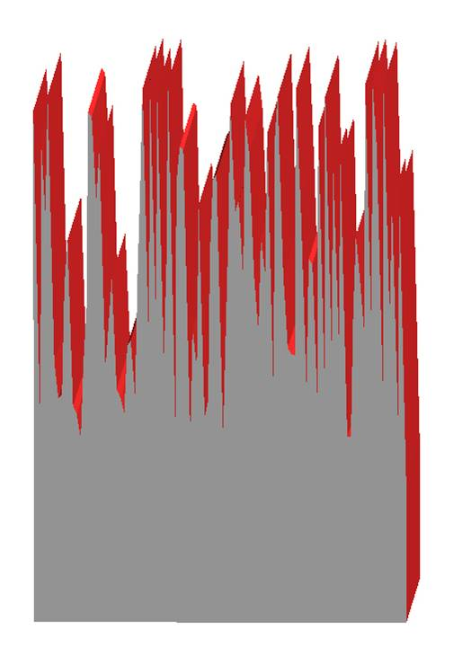
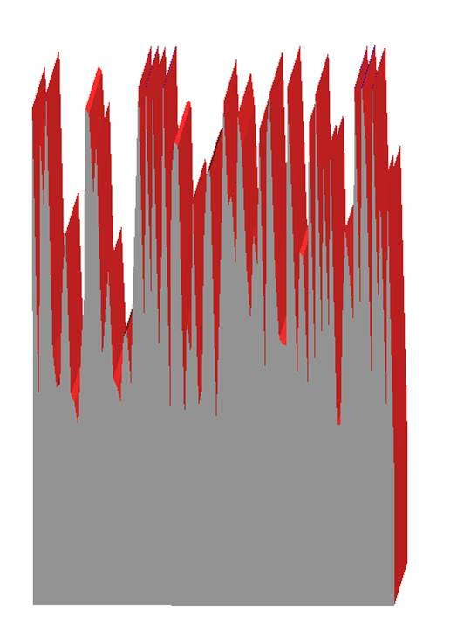
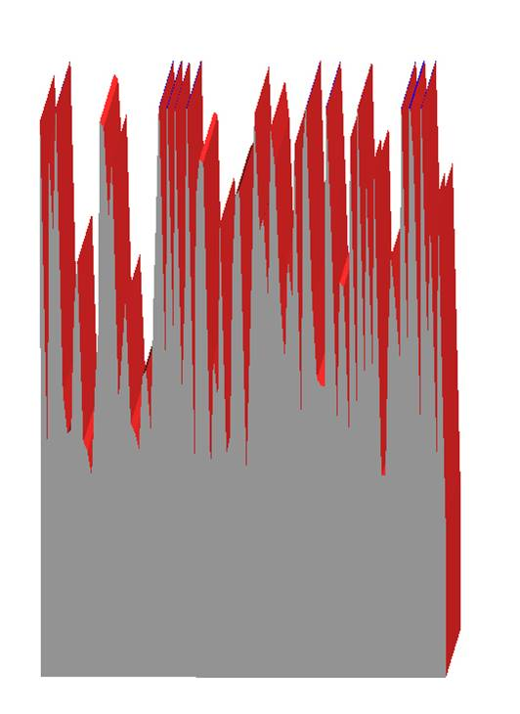
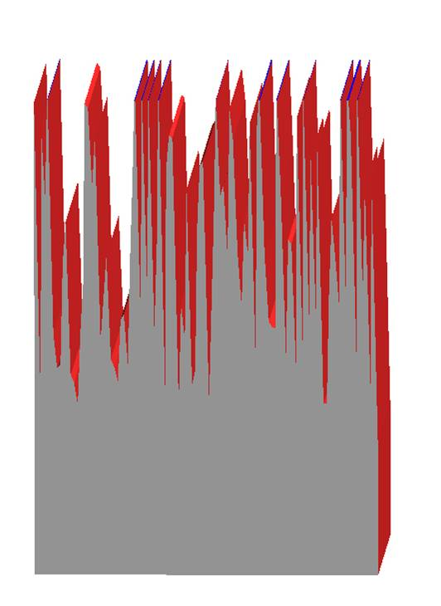
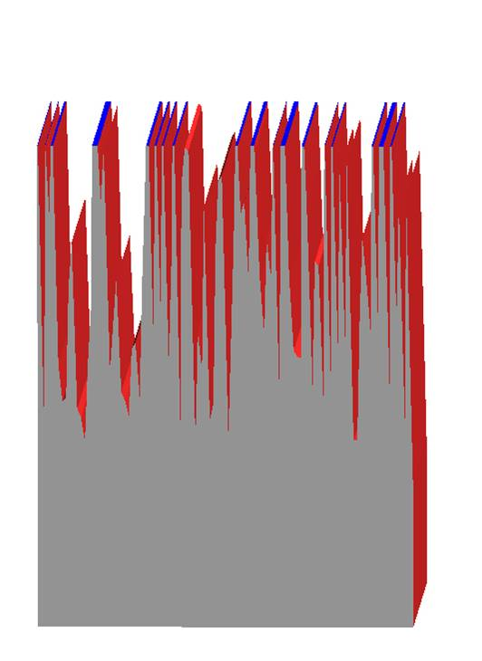
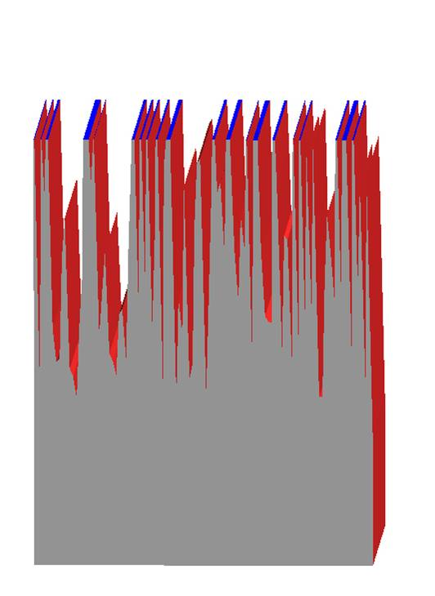
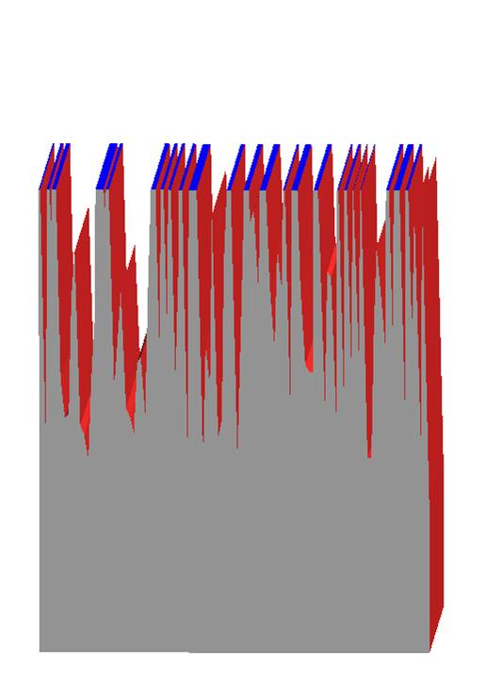
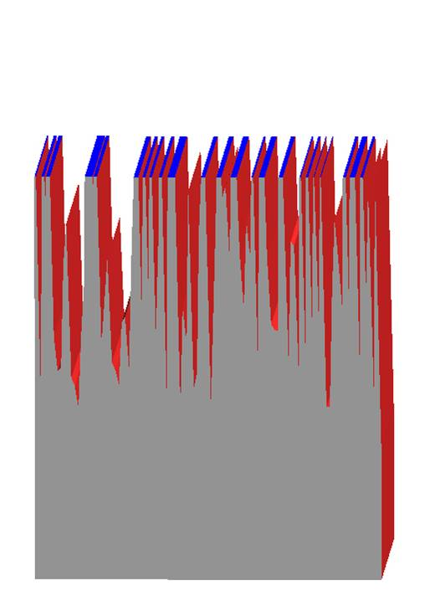
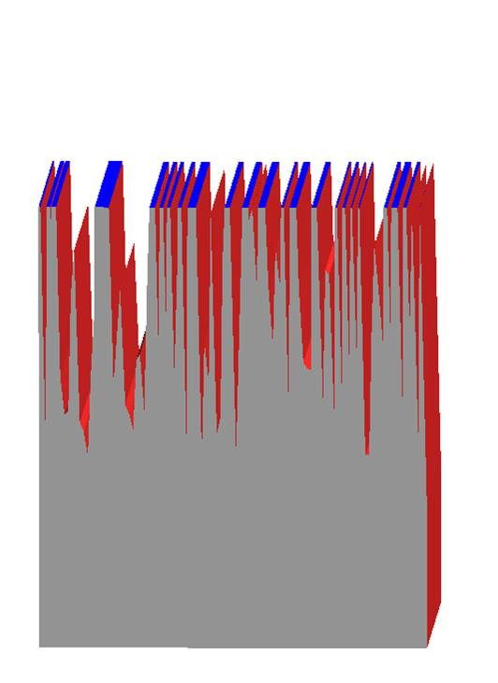
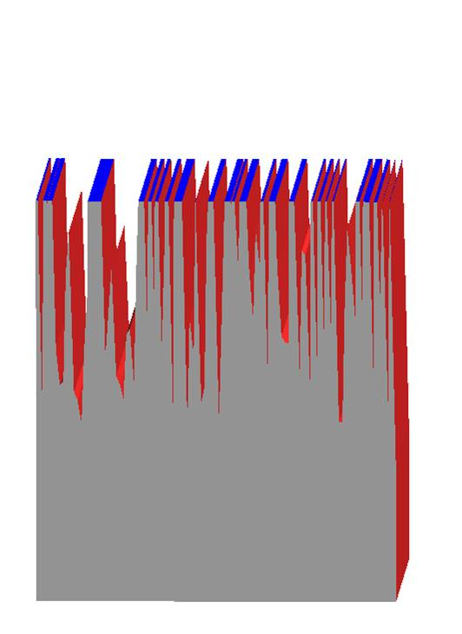
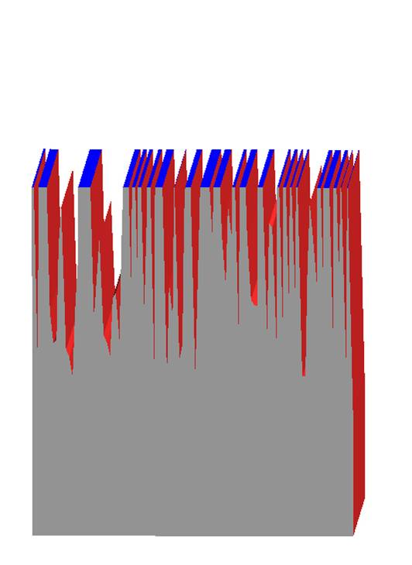
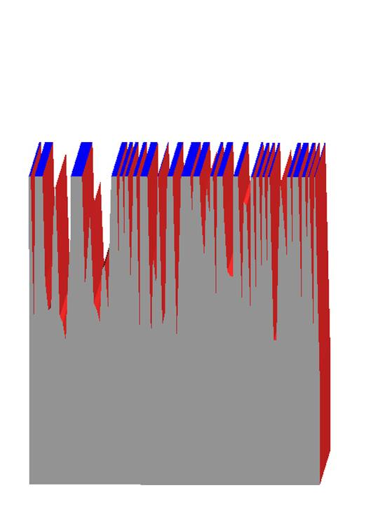
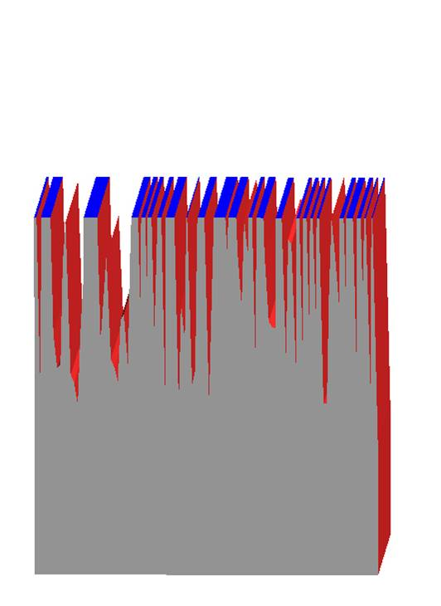
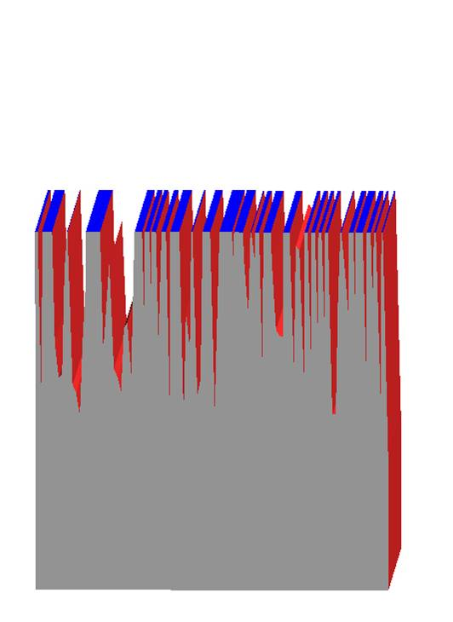
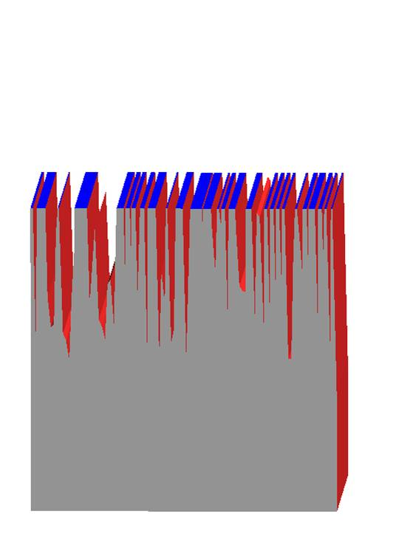
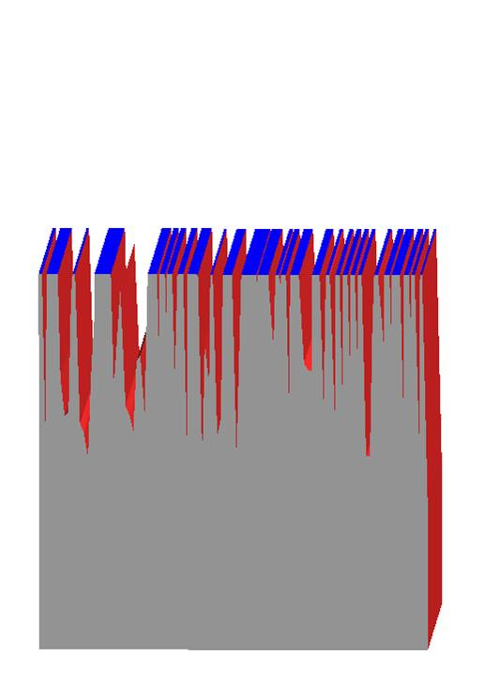
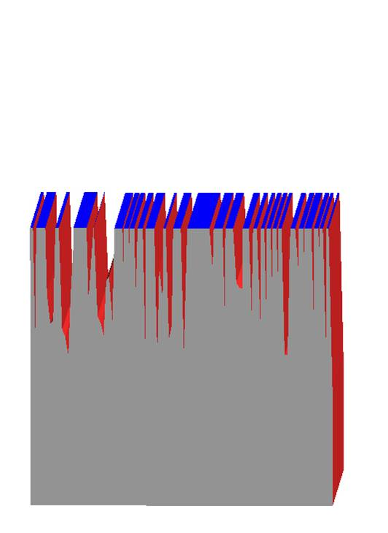
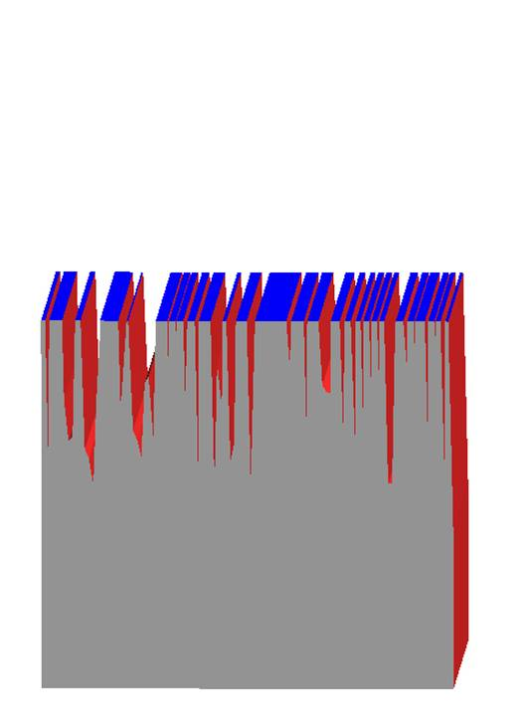
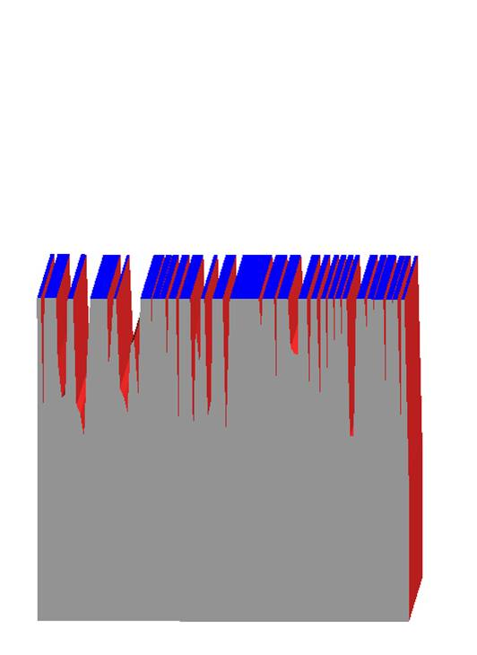
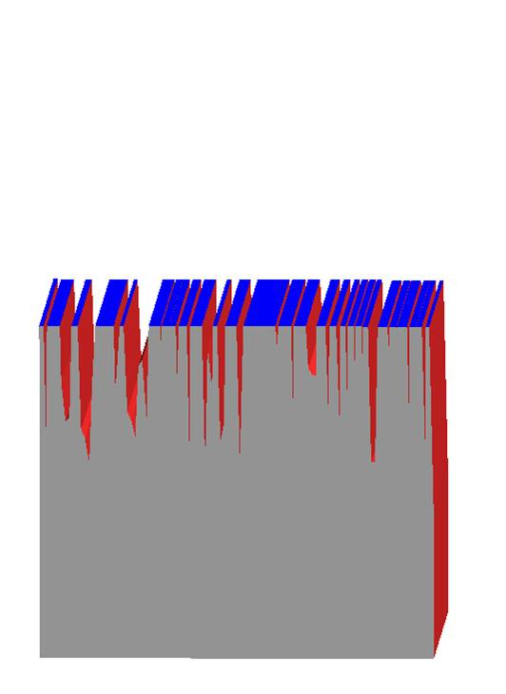
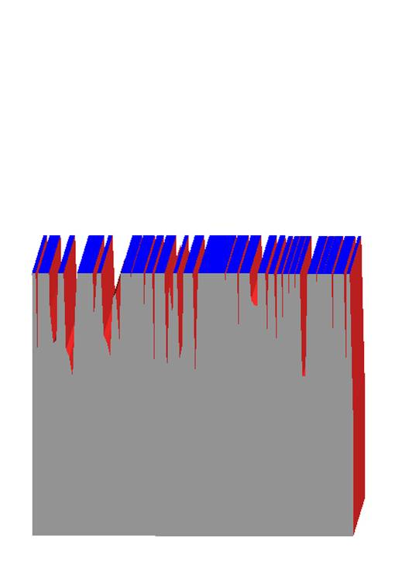
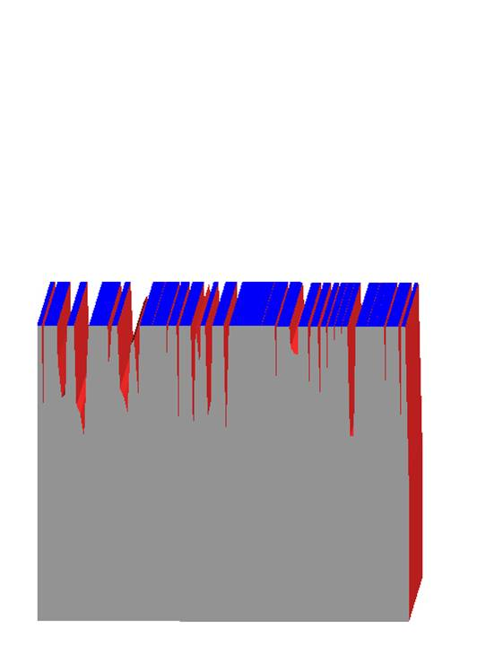
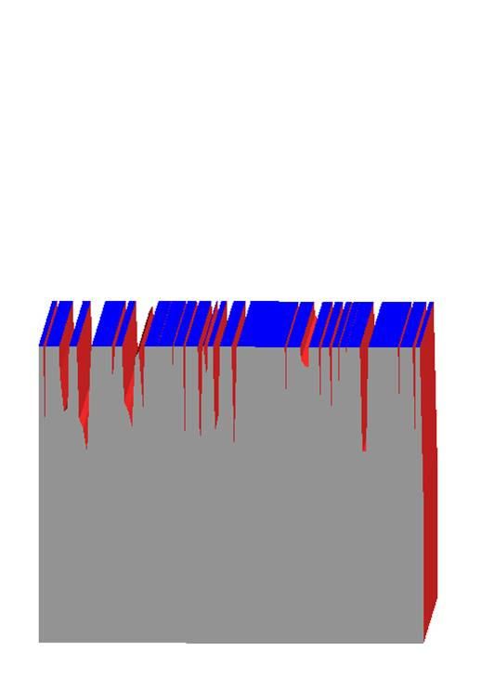
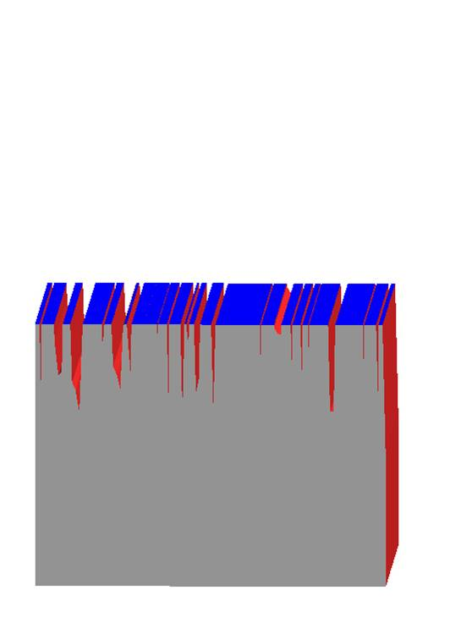
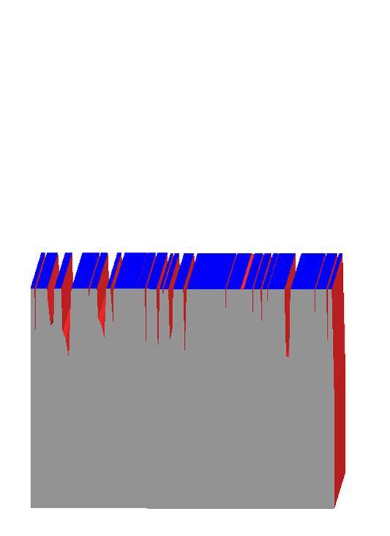
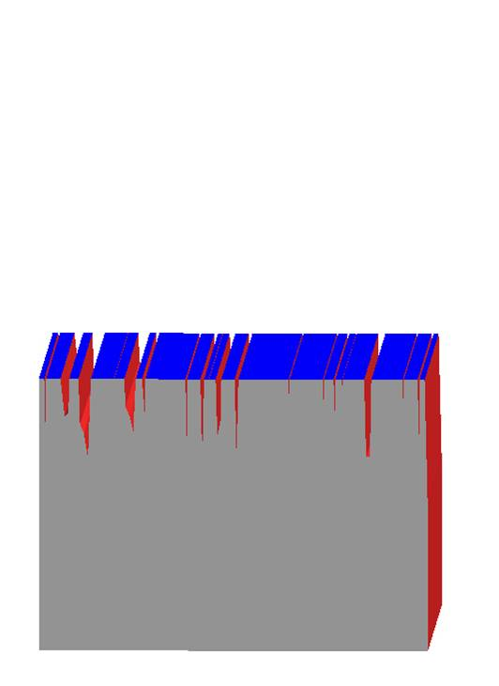
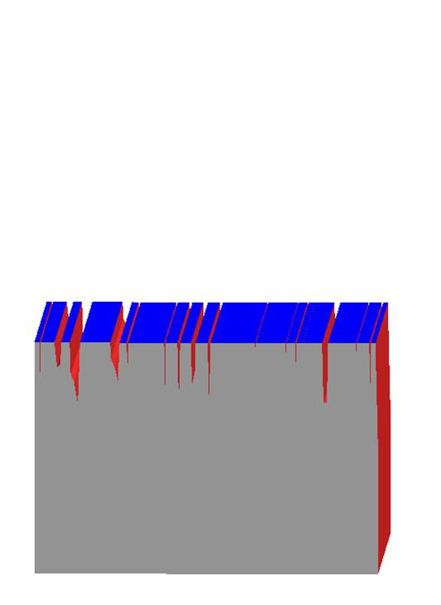
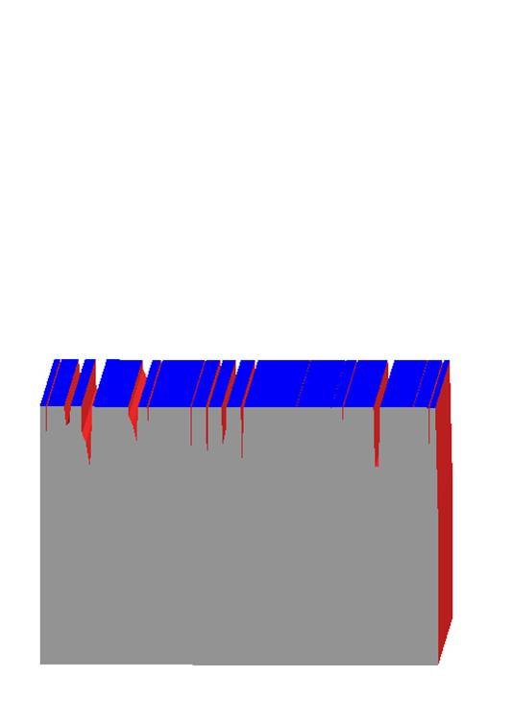
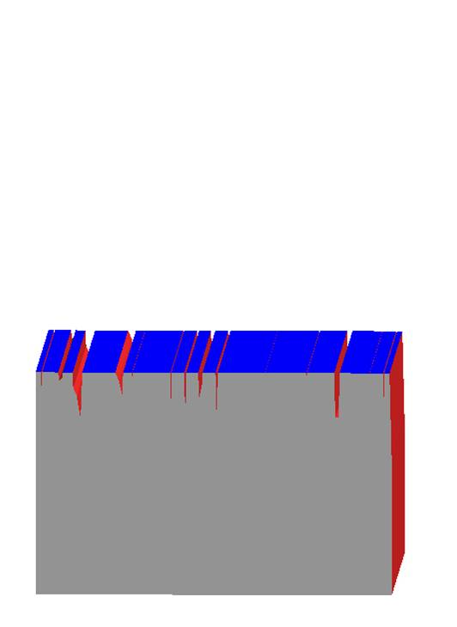
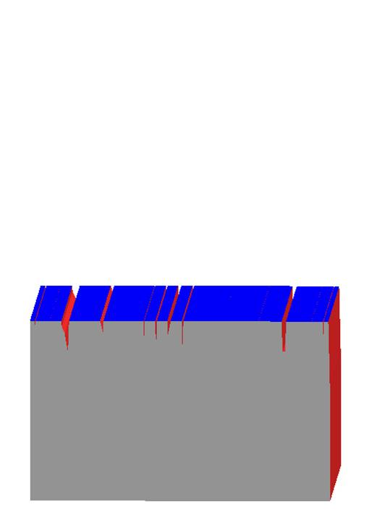
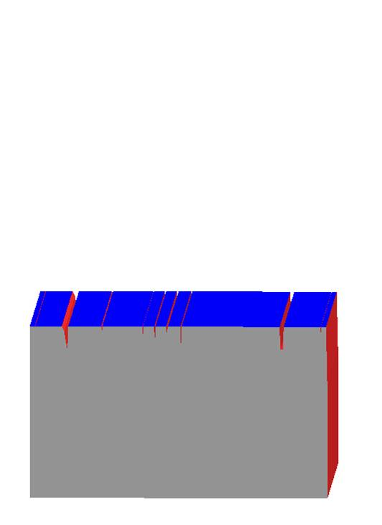
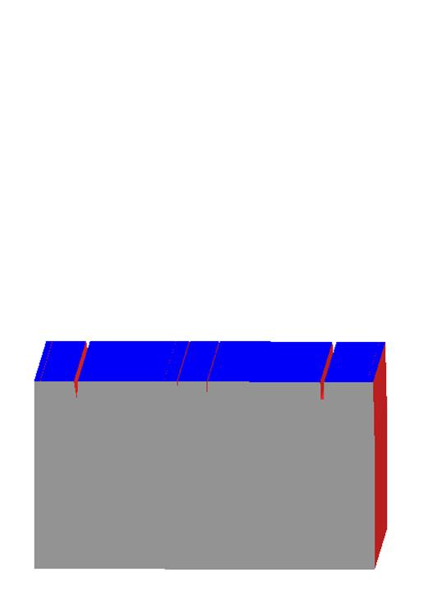
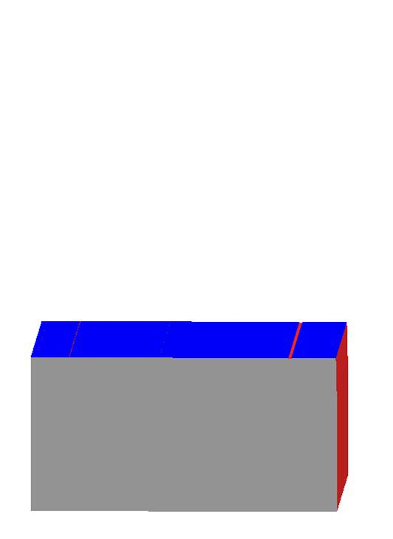
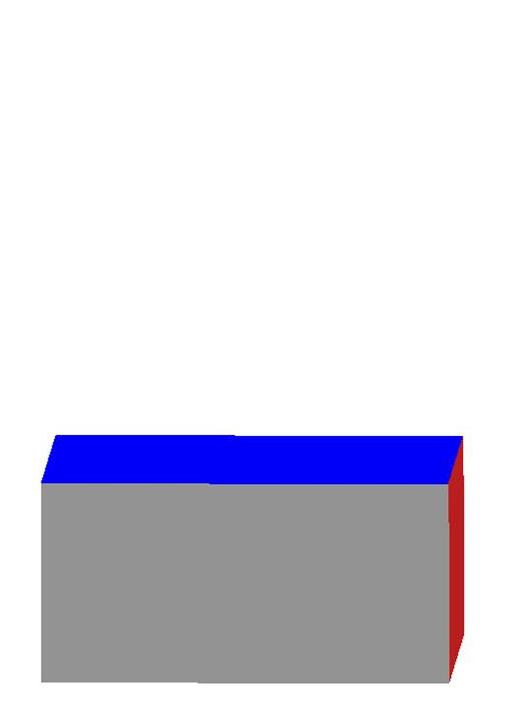
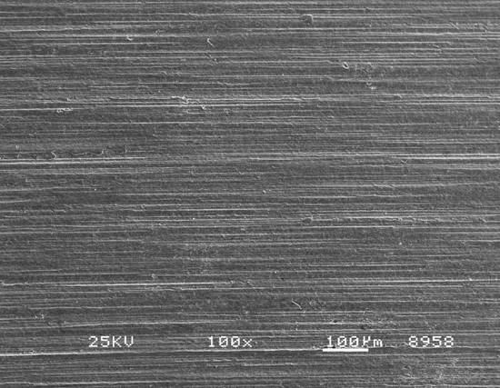
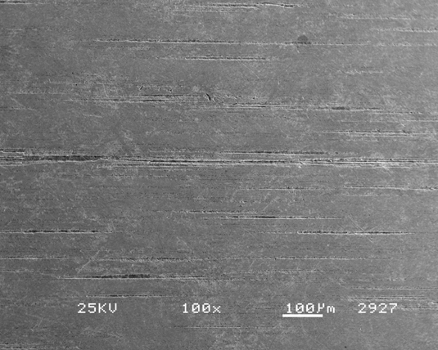
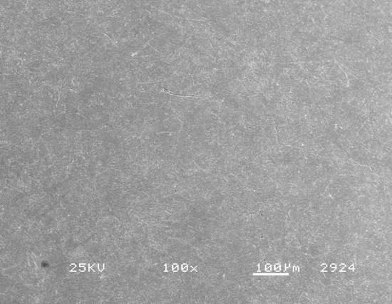
ISF Processing; the Planarization Mechanism
ISF chemistry forms a soft conversion coating
ISF HDNA media generates final micro-texture surface
The as-ground surface becomes an ISF surface

Slide 20
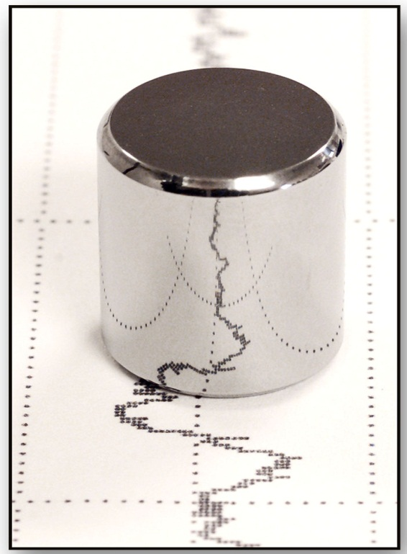
This ISF Process; Final Finish
The ISF Process
The final ISF finish
Ra = 2.49 µinches
Rmax = 0.098 µm
Final Profilometry Trace
© 2015 REM Chemicals, Inc.

Slide 21
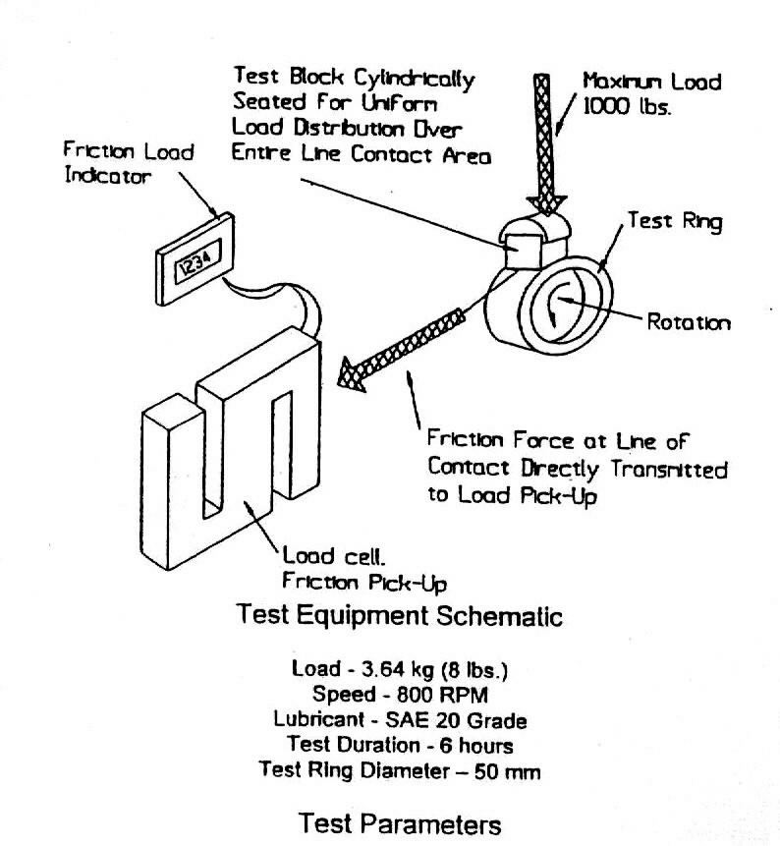
ISF Advantages “Eliminate Component Break-in”
Schematic Diagram; Block-on-Ring Test
Block-on-Ring Test
Block held on rotating
ring under constant load
of 8 lbs.
Temperature of lubricant
bath monitored during
test
© 2015 REM Chemicals, Inc.

Slide 22
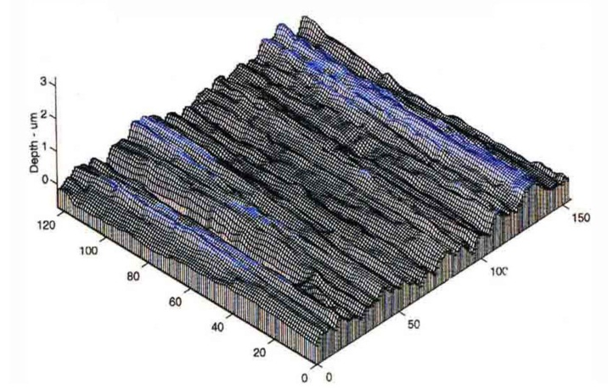
ISF Advantages “Eliminate Component Break-in”
Block-on-Ring Specimen Preparation
Sample I.D. | Surface R_{a} Value
Control Sample Ground Block #1 | 25 μin. or 0.64 μm
Control Sample Ground Block #2 | 29 μin. or 0.75 μm
ISF Prepared Block Specimen #1 | 2.3 μin or 0.06 μm
ISF Prepared Block Specimen #2 | 5.1 μin or 0.13 μm
Control Ground Specimen
ISF Prepared Specimen
© 2015 REM Chemicals, Inc.

Slide 23
No Component Break-in; Parts Run Cooler
Block-on-Ring Test Results
Traditional Ground Block
Break-in temperature spike
Higher final operating temp.
ISF Prepared Block
No break-in temp spike
Lower final operating temp.
© 2015 REM Chemicals, Inc.

Slide 24
Reducing Parasitic Friction; Parts Run Smoother
Reduction of Parasitic Friction
Full ISF Refined Bearing set ran 34º F cooler at highest loading
© 2015 REM Chemicals, Inc.

Slide 25
ISF Advantages; “Virtual Elimination of Contact Fatigue”
Virtual Elimination of Contact Fatigue
Schematic of Rolling/Sliding Contact (R/SCF) Fatigue Test Rig
Test Specifics
43% negative slide
on specimen
Test loading at 400,
425 & 450 KSI
Successful test run
= 20 million cycles
© 2015 REM Chemicals, Inc.

Slide 26
ISF Advantages; “Virtual Elimination of Contact Fatigue”
Virtual Elimination of Contact Fatigue
R/SCF Test Pin & Load Roller
Specimen Specifics
SAE 9310H
Carburized Rc 60-65
Ra = 15μin/0.6μm
1” diameter pin
5” diameter roller
© 2015 REM Chemicals, Inc.

Slide 27
ISF Advantages; “Virtual Elimination of Contact Fatigue”
Virtual Elimination of Contact Fatigue
R/SCF Sample Preparation Parameters
Sample Identification | Test Component Surface Ra Value
Ground Components Control Standard | 15 μinches or 0.38 μm
ISF Prepared Components | 1.5 μinches or 0.04 μm
© 2015 REM Chemicals, Inc.

Slide 28
ISF Advantages; “Virtual Elimination of Contact Fatigue”
Virtual Elimination of Contact Fatigue
R/SCF Test Contact Fatigue Pitting Results
Ground to Ra = 16μin Control Standard Samples
Sample I.D. | Contact Stress Load in ksi | Test Duration in million cycles | Failure Mode
#1 | 400 | 3.6 | Pitted
#2 | 400 | 4.2 | Pitted
#3 | 400 | 3.5 | Pitted
© 2015 REM Chemicals, Inc.

Slide 29
ISF Advantages; “Virtual Elimination of Contact Fatigue”
Virtual Elimination of Contact Fatigue
R/SCF Test
Photographic Results
Photo Shows
Pitting Failure of 1” Ground Control Standard Specimen after 3.5 million cycles @ 400 KSI Contact Stress Loading
© 2015 REM Chemicals, Inc.

Slide 30
ISF Advantages; “Virtual Elimination of Contact Fatigue”
Virtual Elimination of Contact Fatigue
R/SCF Test Results ISF Prepared Specimens
Sample I.D. | Contact Stress Loading in ksi | Duration in millions of cycles | Failure Mode
#1 | 400 | 20.0 | No Failure
 | 425 | 20.0
 | 450 | 22.4
Cumulative Result | 400-450 | 62.4 | No Failure
#2 | 400 | 5.0* | No Failure
 | 425 | 5.0*
 | 450 | 20.0
Cumulative Result | 400-450 | 30.0 | No Failure
© 2015 REM Chemicals, Inc.

Slide 31
ISF Advantages; “Virtual Elimination of Contact Fatigue”
Virtual Elimination of Contact Fatigue
R/SCF Test
Photographic Results
Photo Shows
1” REM ISF Specimen after
62.4 million cycles @ 400,
425 & 450 KSI Contact Stress Loading
© 2015 REM Chemicals, Inc.

Slide 32
ISF Advantages; “Virtual Elimination of Contact Fatigue”
Virtual Elimination of Contact Fatigue
Combined R/SCF Test Photographic Results
Top Photo
Standard Ground Specimen
after 3.5 million cycles
Pitting Failure
Bottom Photo
REM ISF Specimen
after 62.4 million cycles
No Pitting Failure
© 2015 REM Chemicals, Inc.

Slide 33
ISF Advantages; Benefits of an ISF Surface
Conclusion; Benefits of ISF
Eliminate Component Break-on with controlled asperity planarization
Eliminate metal debris in the lubricant stream
More efficient metal-to-metal surface contact increases power density
Compressive contact stresses are diffused over a larger area
Reduction of parasitic, frictional heat generation. Parts run cooler
More efficient transfer of energy at metal-to-metal contact surfaces
Reduction of contact fatigue failure
Improved surface quality reduces onset of corrosion
Improved surface quality electroplates more efficiently
© 2015 REM Chemicals, Inc.

Slide 34
ISF Advantages; “Reduction of Surface Contact Stress”
REM Surface Engineering
www.remchem.com
Surface Engineering Specialists
An ISO9001:2015/AS9100 Rev D Certified Company With Offices In:
Manufacturing and JSS in Southington, CT
Serial Production Volume JSS in Merrillville, IN
Engineering, R&D, Manuf. and JSS in Brenham, TX
Corporate Offices in Austin, TX
Manufacturing and JSS in St. Neots, Cambridgeshire, U.K.
© 2015 REM Chemicals, Inc.

